Slide 1

UNIVERSITY COLLEGE OF ENGINEERING (BIT CAMPUS) TIRUCHIRAPPALLI
HANDWRITTEN SIGNATURE FORGERY DETECTION USING CNN WITH EXPLAINABLE AI
SUBMITTED
KIRUTHIKA K (810022205060)
JENCY SHAGAYA SALINI (810022205076)
GUIDED BY
MRS. C. KANIMOZHI
ASSISTANT PROFESSOR
DEPARTMENT OF IT

Slide 2
ABSTRACT :
The Handwritten Signature Forgery Detection system is developed to automatically identify whether a given signature is genuine or forged using deep learning techniques. The system analyzes signature images by extracting important visual features such as strokes, curves, and writing patterns. A Convolutional Neural Network (CNN) model with InceptionV3 architecture is used to improve classification accuracy.Data preprocessing techniques like resizing, normalization, and noise removal are applied to enhance input quality. The model is trained on both genuine and forged signature datasets to learn distinguishing features. Explainable AI using Grad-CAM is integrated to provide visual explanations by highlighting important regions in the signature.

Slide 3
PROBLEM STATEMENT:
Signature forgery is a common issue in financial institutions and legal documentation, leading to fraud and security risks.
Traditional methods of signature verification rely heavily on manual inspection, which is time-consuming and prone to human error.
Skilled forgeries are difficult to detect even by experts, making the process unreliable.
Existing systems lack automation and fail to provide consistent and accurate results.
There is a need for an intelligent system that can automatically detect forged signatures with high accuracy and also provide clear explanations for its decisions.

Slide 4
EXISTING SYSTEM :
Many traditional approaches use manual verification or basic machine learning techniques such as Support Vector Machines (SVM) and K-Nearest Neighbors (KNN) for signature classification.
These methods depend on handcrafted features and require domain expertise. Some systems use image processing techniques to analyze signature patterns.
Although these approaches provide moderate accuracy, they are not robust enough to handle variations in handwriting styles and complex forgery patterns.
Notes:
LIMITATION:
Most existing systems suffer from low accuracy due to limited feature extraction capability. They require manual feature engineering, which increases complexity and reduces efficiency.
These systems do not provide explainability, making it difficult to understand the model’s decision. They also struggle to detect s

Slide 5
LIMITATION:
Most existing systems suffer from low accuracy due to limited feature extraction capability.
They require manual feature engineering, which increases complexity and reduces efficiency.
These systems do not provide explainability, making it difficult to understand the model’s decision.
They also struggle to detect skilled forgeries and lack real-time processing capability.

Slide 6
OBJECTIVES :
The main objective of this project is to develop an automated system for signature forgery detection using deep learning techniques.
The system aims to accurately classify signatures as genuine or forged using a CNN-based model.
It also focuses on improving reliability by integrating Explainable AI techniques like Grad-CAM to provide visual interpretation of results.
Another objective is to achieve high accuracy and fast prediction suitable for real-world applications.

Slide 7
PROPOSED SYSTEM:
Uses Deep Learning (CNN) for signature verification
Implements InceptionV3 architecture for feature extraction
Applies Transfer Learning for better accuracy
Performs automatic feature extraction (no manual work)
Includes image preprocessing (resize, normalize, noise removal)
Classifies signatures as Genuine or Forged
Uses Sigmoid activation for probability prediction
Integrates Grad-CAM for explainable results
Generates confidence score + heatmap visualization
Provides fast, accurate, and reliable output

Slide 8
METHODOLOGIES:
Data Collection – Gather genuine and forged signature images
Data Preprocessing – Resize, normalize, and remove noise
Data Splitting – Divide into training, validation, and testing sets
Model Selection – Use CNN with InceptionV3 architecture
Transfer Learning – Apply pre-trained weights for better performance
Feature Extraction – Extract signature patterns (strokes, curves)
Model Training – Train using labeled dataset
Model Validation – Evaluate performance during training
Prediction – Classify as Genuine or Forged using threshold
Explainable AI – Use Grad-CAM for heatmap visualization

Slide 9
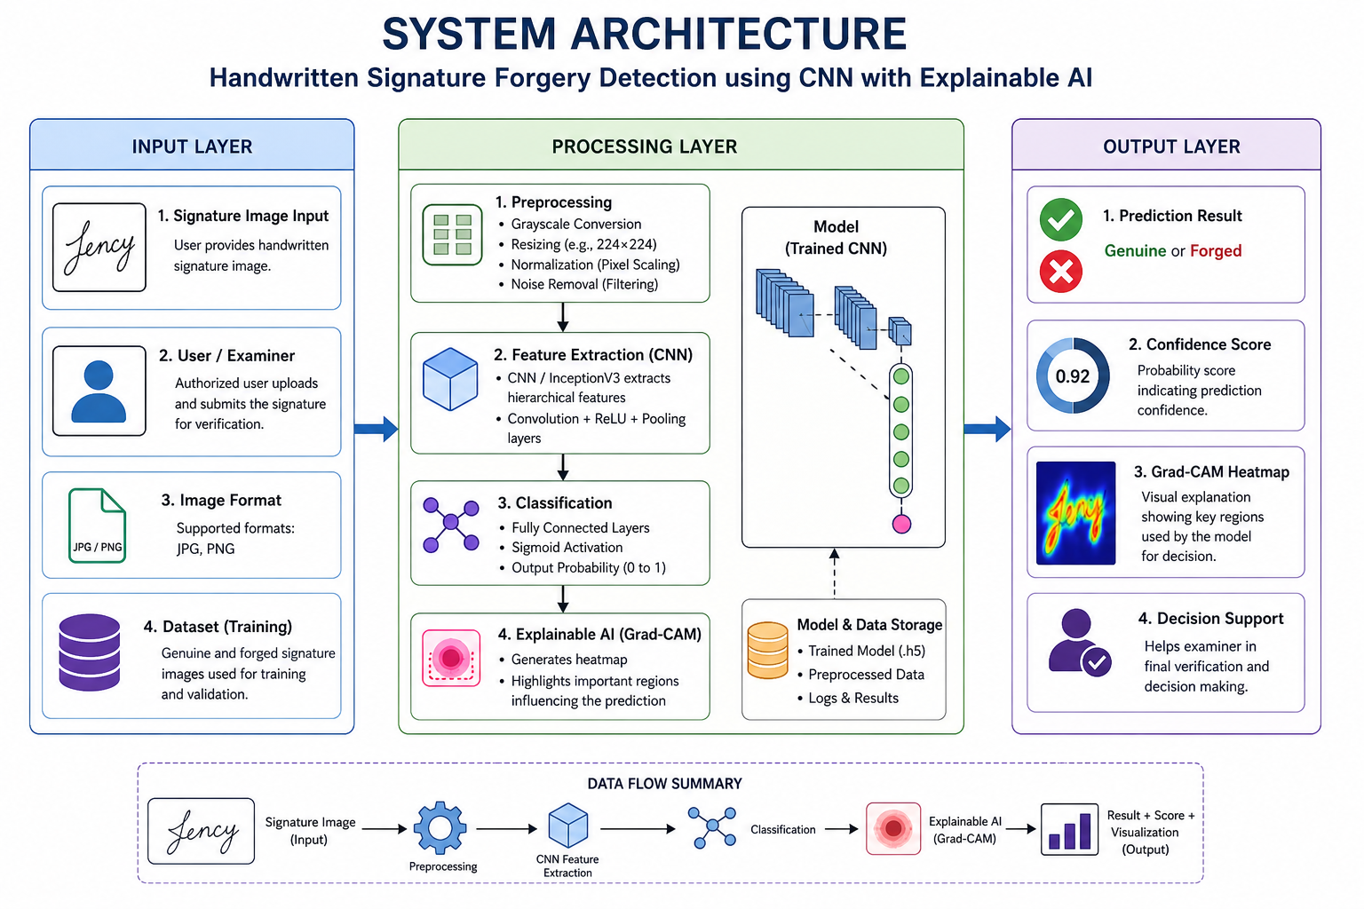
ARCHITECTURAL DESIGN FOR PROPOSED SYSTEM:

Slide 10
TECHNOLOGIES & MACHINE LEARNING MODELS:
Python – Programming language
TensorFlow & Keras – Deep learning frameworks
CNN (InceptionV3) – Feature extraction & classification
Transfer Learning – Improves accuracy
OpenCV – Image preprocessing
Matplotlib – Graph visualization
Google Colab – Training with GPU support
Grad-CAM – Explainable AI (heatmap visualization)

Slide 11
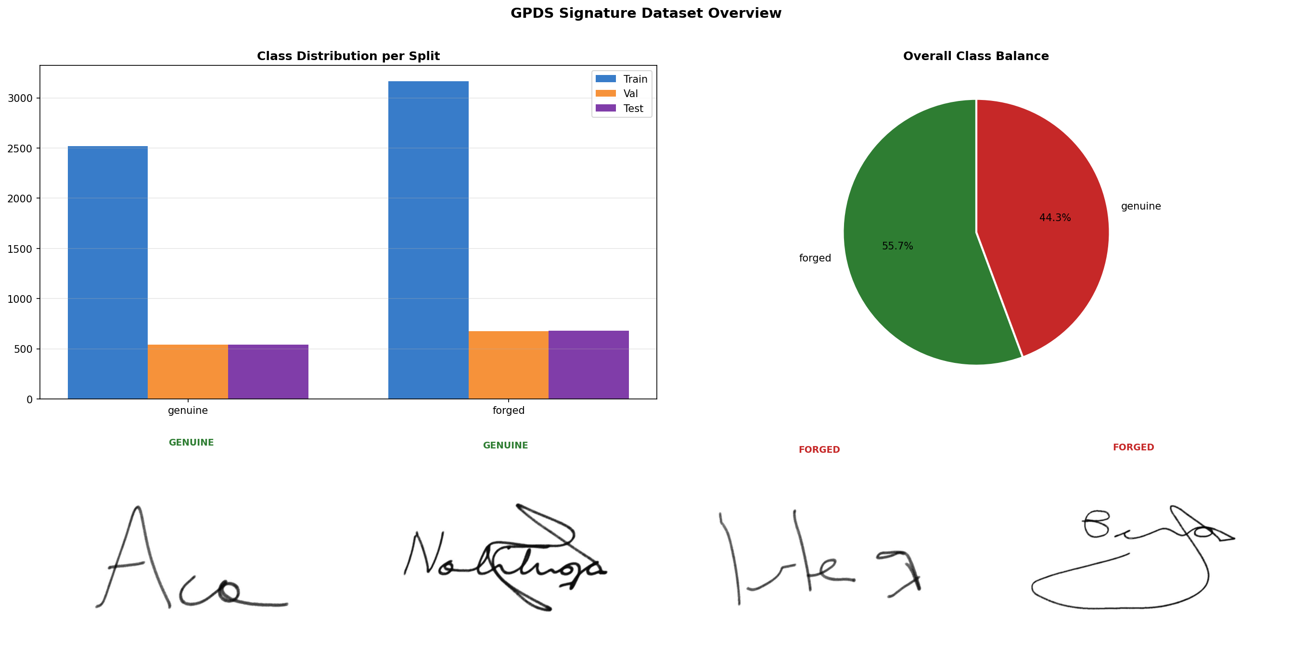
GPDS Signature Dataset Overview:

Slide 12
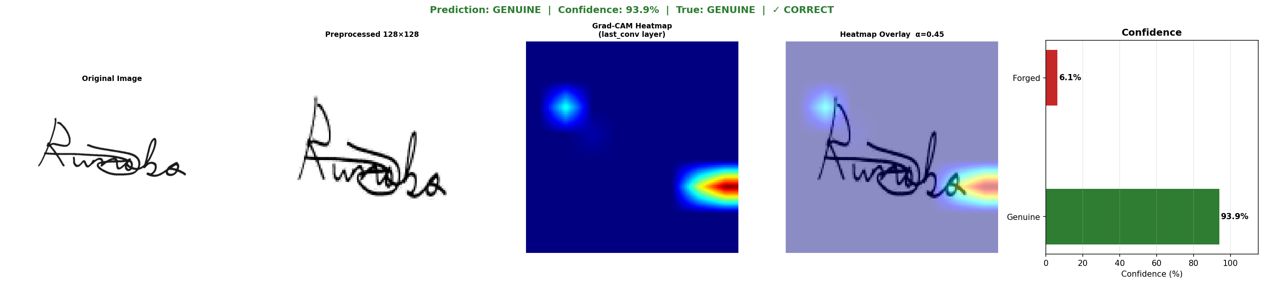
Prediction output of signature Forgery detection:

Slide 13
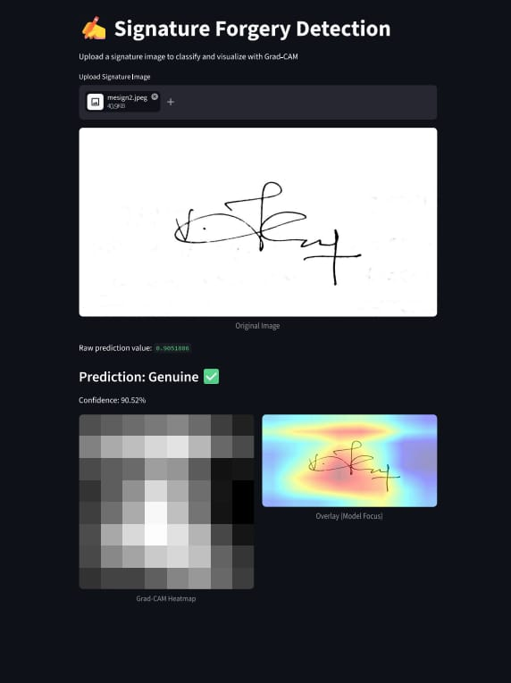
Final Prediction Result:

Slide 14
LITERATURE SURVEY
Paper Title | Authors & Year | Findings | Pros | Cons
Offline Signature Verification using CNN | Hafemann et al.,2017 | CNN model used to learn signature patterns and classify genuine vs forged signatures with high accuracy | Automatic feature extraction; High accuracy | Requires large datset; Computational cost
Signature Verification using Deep Learning | Dey et al.,2018 | Deep neural networks improve verification accuracy compared to traditional ML methods | Better performance; Handles complex patterns | Needs training time Overfitting risk
Transfer Learning using InceptionV3 for Image Classification | Szegedy et al., 2016 | InceptionV3 model extracts deep features and improves classification results | High accuracy; Pretrained model reduces effort | Complex architecture; Requires GPU
Offline Signature Forgery Detection using CNN | Soleimani et al., 2019 | CNN detects forged signatures based on texture and stroke features | Good forgery detection; Robust model | Sensitive to image quality

Slide 15
OUTCOMES :
High accuracy (around 85–90%) in detecting forged signatures
Correct classification of Genuine vs Forged signatures
Fast and reliable prediction results
Ability to handle variations in handwriting styles
Detection of complex and skilled forgeries
Visual explanation using Grad-CAM heatmaps
Improved transparency and trust in predictions
Suitable for real-world applications like banking and fraud detection

Slide 16
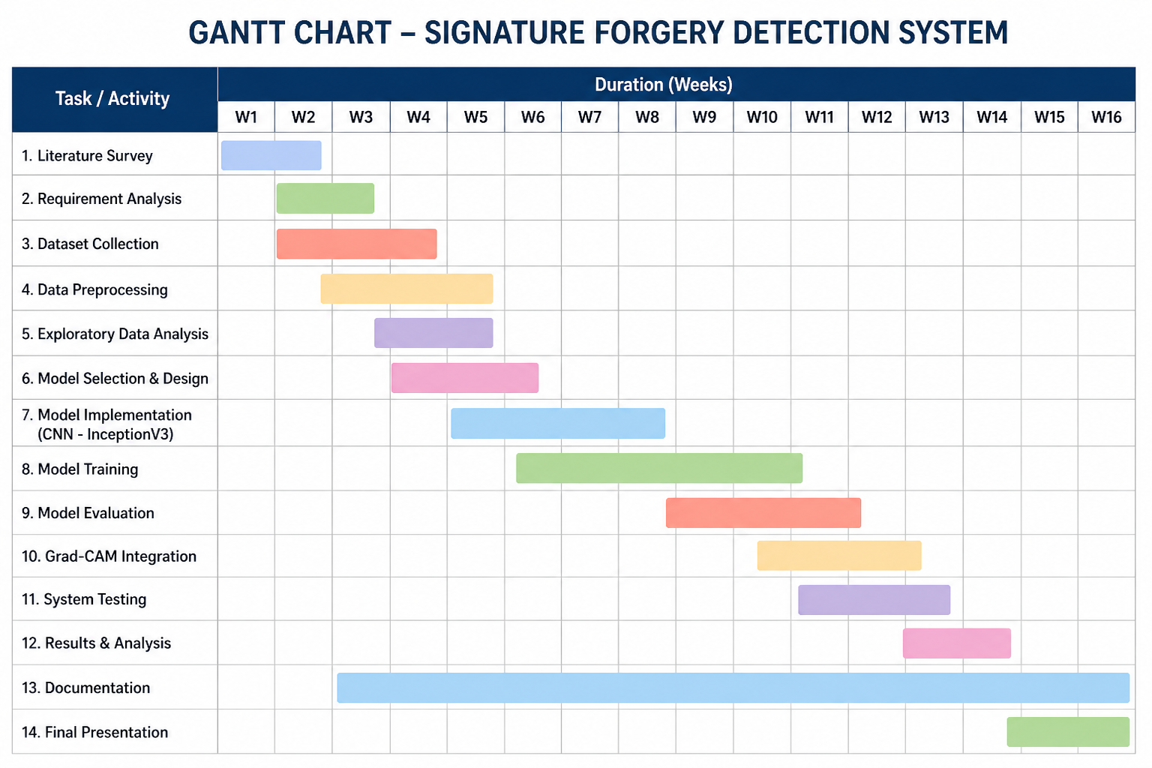

Slide 17
Applications:
Banking Systems – Cheque signature verification
Legal Documents – Contract and agreement validation
Fraud Detection – Prevent identity and financial fraud
Government Offices – Document authentication
Insurance Sector – Claim verification
Digital Platforms – e-signature verification
Forensic Analysis – Handwriting and signature examination
Access Control Systems – Identity verification using signatures

Slide 18
CONCLUSION :
The proposed signature forgery detection system successfully utilizes a Convolutional Neural Network based on the InceptionV3 architecture to accurately classify signatures as genuine or forged. By applying preprocessing techniques and transfer learning, the model achieves high accuracy in identifying complex signature patterns. The integration of Grad-CAM enhances the system by providing visual explanations through heatmaps, making the predictions more transparent and understandable. Overall, the system delivers fast, reliable, and explainable results, making it suitable for real-world applications such as banking, legal verification, and fraud detection.

Slide 19
REFERENCES
1. Writer-Independent Offline Signature Verification using CNN M. Hafemann, R. Sabourin, and L. S. Oliveira, “Writer-Independent Offline Signature Verification using Convolutional Neural Networks,” IEEE Transactions on Information Forensics and Security, 2017. https://ieeexplore.ieee.org/document/7830858
2. Learning Features for Offline Signature Verification using Deep CNNs L. S. Oliveira et al., “Learning Features for Offline Handwritten Signature Verification using Deep Convolutional Neural Networks,” IEEE Transactions on Pattern Analysis and Machine Intelligence, 2016. https://ieeexplore.ieee.org/document/7467346
3.Offline Signature Verification: A Survey A. K. Jain, F. D. Griess, and S. D. Connell, “Offline Signature Verification: A Survey,” Pattern Recognition, 2002. https://www.sciencedirect.com/science/article/pii/S003132030200118X
4. ImageNet Classification with Deep CNNs A. Krizhevsky, I. Sutskever, and G. Hinton, “ImageNet Classification with Deep Convolutional Neural Networks,” NIPS, 2012. https://papers.nips.cc/paper/4824-imagenet-classification-with-deep-convolutional-neural-networks
5. How Transferable are Features in Deep Neural Networks J. Yosinski et al., “How Transferable are Features in Deep Neural Networks?” NIPS, 2014. https://arxiv.org/abs/1411.1792

Slide 20
REFERENCES
6. An Introduction to ROC Analysis T. Fawcett, “An Introduction to ROC Analysis,” Pattern Recognition Letters, 2006 .https://www.sciencedirect.com/science/article/pii/S016786550500303X
7.Explainable Artificial Intelligence: A Survey A. Adadi and M. Berrada, “Peeking Inside the Black-Box: A Survey on Explainable AI,” IEEE Access, 2018. https://ieeexplore.ieee.org/document/8466590
8. Deep Inside Convolutional Networks Visualising Image Classification Models K. Simonyan et al., “Deep Inside Convolutional Networks: Visualising Image Classification Models,” ICLR Workshop, 2014. https://arxiv.org/abs/1312.6034
9. GPDS Signature Corpus J. Vargas et al., “Off-line Signature Verification based on Grey Level Information using Texture Features,” Pattern Recognition, 2011. https://www.sciencedirect.com/science/article/pii/S0031320310004244
10. Adam Optimizer D. P. Kingma and J. Ba, “Adam: A Method for Stochastic Optimization,” ICLR, 2015. https://arxiv.org/abs/1412.6980

Slide 21
THANK YOU

